Slide 1
Electronic properties of 2D van der Waals magnets
Chase Hanson
Mentor: Antia Botana

Slide 2



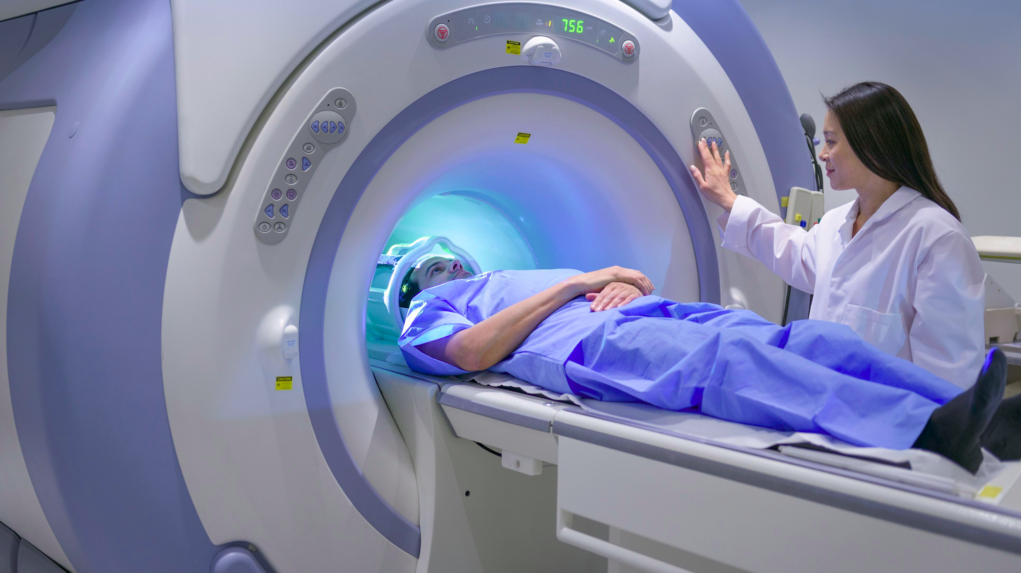
Background - the motivation is two-fold
Magnetism is an integral part of our society
...And its atomic origin is also the key to understanding bizarre physical phenomena, like superconductivity
Notes:
Magnetic materials are extremely technologically important, examples include the humble compass, hard drives and other forms of information storage, medical imaging techniques, and transportation. The train shown above is China’s new Maglev train.

Slide 3
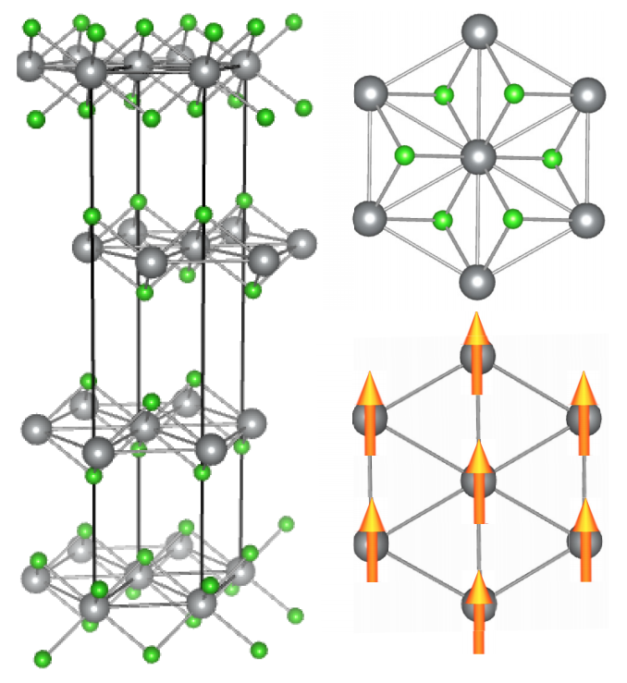
Two dimensional magnets
Atomically thin
Strongly bonded - flexible
Layered - stackable
Highly symmetric - tunable
We are looking at theoretical ferromagnetic and antiferromagnetic crystals of transition metals and halides
(V, Mn, Fe, Co, Ni) + 2(Cl, Br, I)
Notes:
2D magnets offer additional practicality due to their restriction to a plane. They’re atomically thin, flexible due to strong bonds, stackable to due layering, and offer precise tuning properties based on structure and temperature.

Slide 4
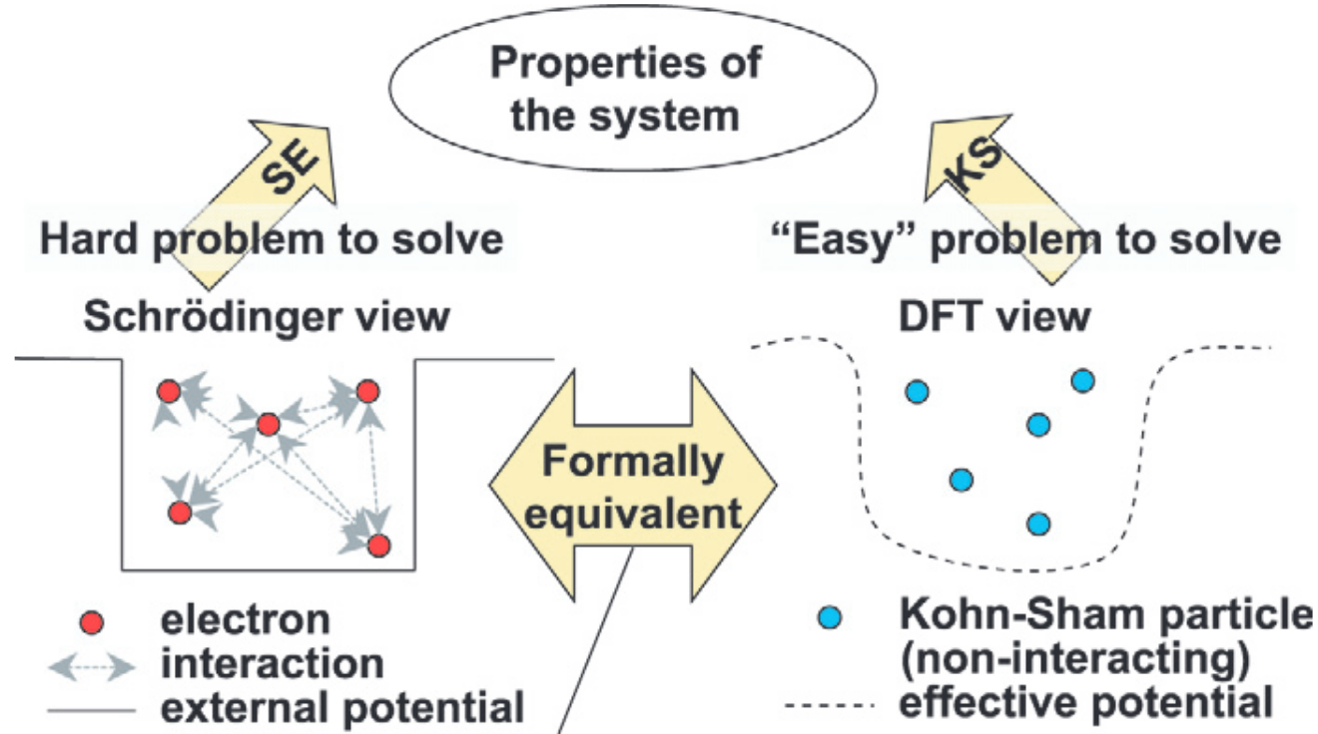
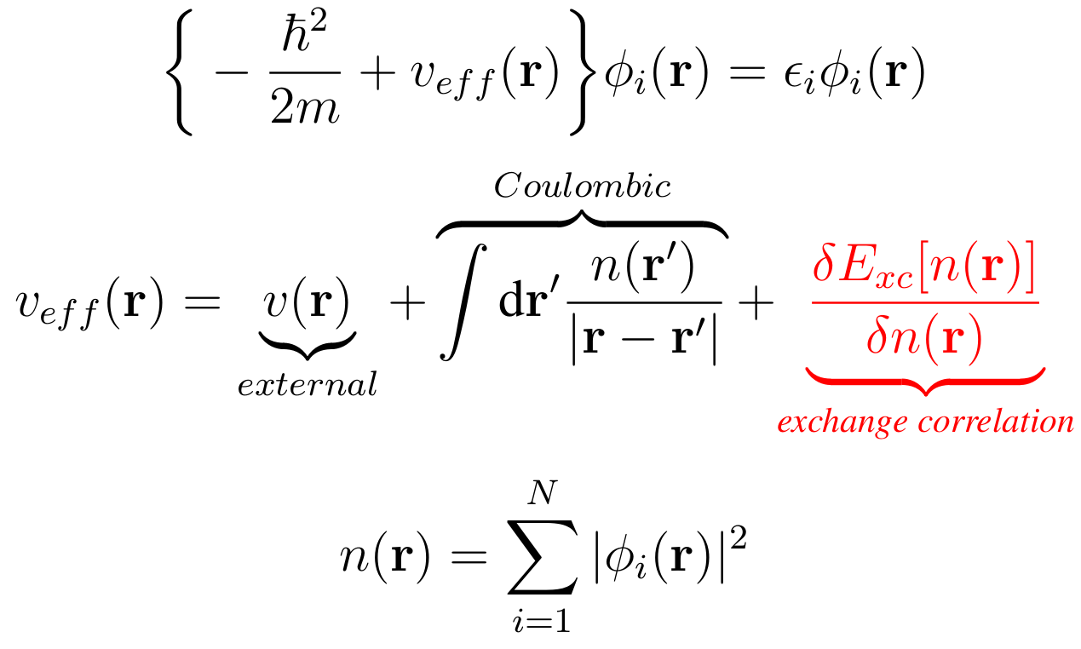
An aside: the many body problem
Density Functional Theory
Notes:
DFT uses spin orbitals to predict ground-state electron density, total energy, and related relevant properties. In this way, it provides a useful compromise between accuracy and computational efficiency. Modern computers allow for routine calculations involving hundreds of atoms--far more than with traditional quantum chemical methods, but with a reasonable and, depending on some approximations, high degree of accuracy \cite{wien}.
In our work on 2D vdW magnets, we have used ASU's research computing facilities (on the supercomputing cluster, Agave) to run DFT calculations.
In the study of 2D magnetic materials, DFT calculations serve two primary purposes: 1) They provide us with a calculation of the relative stability of these systems as purely two-dimensional, and 2) they allow us to accurately estimate magnetic interactions.

Slide 5
Experimentally feasible 2d magnets
We start by obtaining real, experimental data for bulk materials (in this case MX2).
Then we isolate single plane layers.
Finally we do our calculations using DFT. (Many times, because there are always errors)
Notes:
Using DFT-based calculations, we have studied the evolution of the electronic and magnetic properties of transition metal (TM) dihalides \textit{MX}$_{\text{2}}$ from the bulk to monolayer limit, where \textit{M} represents a first-series transition metal ($\textit{M}\hspace{1mm}\text{=}$ V, Mn, Fe, Co, Ni), and $\textit{X}$ represents a halide ion ($\textit{X}\hspace{1mm}\text{=}$ Cl, Br, I). For each TM dihalide, we start by considering the bulk materials for which experimentally-obtained structural and magnetic data exist to benchmark our calculations. See Slide 3 for the layered structure of $\textit{MX}_\text{2}$ materials, in addition to a top-down view of the triangular lattice of the magnetic ($\textit{M}$) ions. Good agreement between theory and experiment has been found for both structural and magnetic properties. From there, we construct our monolayers, effectively isolating the materials to the second dimension. We examine different magnetic configurations--ferromagnetic and antiferromagnetic--and evaluate the ground state of the system by comparing their total energies.

Slide 6
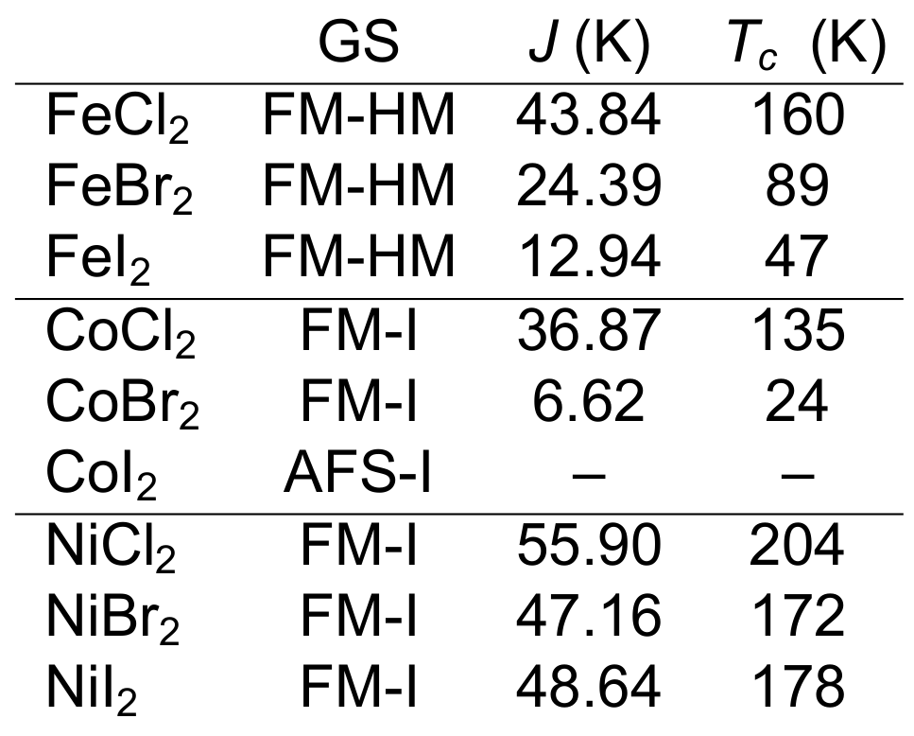
Results thus far
Examining atomic neighbors for the AFS and FM state,
J = E / 8S^2,
where S is the spin per metal atom. For a triangular 2D lattice, the Curie temperature is derived,
T = 3.641*J / kB.
These temperatures are relatively high, meaning they change phase easily (good for applications).
Notes:
A variety of magnetic ground states are obtained for different combinations of transition metal $\textit{M}$ and halide $\textit{X}$ as a result of the competition between different magnetic interactions (namely direct exchange and superexchange). In particular, we find that Fe$\textit{X}_\text{2}$ monolayers are ferromagnetic half-metals, whereas Ni$\textit{X}_\text{2}$, CoCl$_\text{2}$, and CoBr$_\text{2}$ monolayers are ferromagnetic insulators. Monolayers of the other $\textit{MX}_\text{2}$ are antiferromagnetic instead.
FM materials are more interesting from a technological perspective as they can be used for applications in spintronics. In order to estimate the strength of the magnetic interactions in our newly predicted 2D FMs, the exchange constant $\textit{J}$ was obtained from the the Ising model and the energy difference $\Delta \textit{E}$ between a FM and an AFM configuration, which is appropriate from the observed uniaxial anisotropy of these materials. In our case, for the AFS state, a given magnetic ion has four AFM and two FM near neighbors, whereas for the FM state it has six FM near neighbors. Thus, $\textit{J}\hspace{1mm}\text{=}\hspace{0.5mm}{\Delta \textit{E}}/{\text{8}\textit{S}^\text{2}}$, where $\textit{S}$ is the spin per metal atom (2, 3$/$2 and 1 for Fe, Co and Ni, respectively). For a triangular 2D lattice, the transition (Curie) temperature is $\textit{T}_\textit{c}\hspace{0.5mm}\text{=}\hspace{1mm}\text{3.641}\cdot\textit{J}/\text{k}_\text{B}$. Based on this rough estimate, the transition temperatures ($\textit{T}_\textit{c}$) for each of the monolayers are shown in Table \ref{table1}. Those for Ni$\textit{X}_\text{2}$ and FeCl$_\text{2}$ are relatively high, making these materials ideal for robust ferromagnetism at the single-layer level and a strong candidates for technological applications.

Slide 7
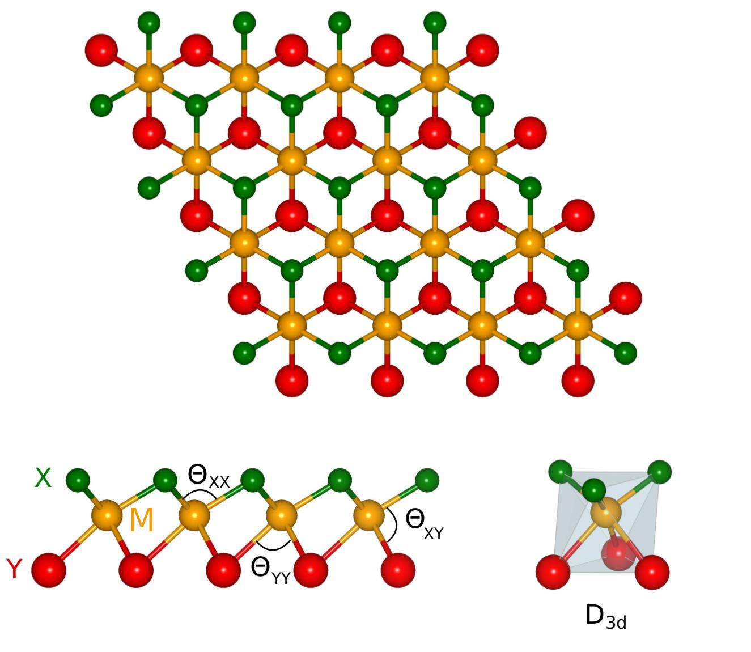
Current Work
Breaking inversion symmetry
New groundstate?
Skyrmions (novel magnetic phases)?
Notes:
We are currently considering Janus configurations of monolayer transition metal dihalides. This will entail a comparison of the $\textit{MX}_\text{2}$ results to those of $\textit{MXY}$ materials, where $\textit{X}\hspace{0.0mm}\not\hspace{-1mm}\text{=}\hspace{1mm}\textit{Y}$ are halogens Cl, Br, and I. These studies will be immensely useful not only in the search for the practical development of 2D magnets, but in understanding the fundamental physics of these novel materials.
In particular, research in Janus dihalides will focus on the effects that inversion symmetry-breaking has in the magnetic and structural properties of these materials. Does the formation of Janus stabilize a different structure at the monolayer level? If a ferromagnetic ground state is kept, is the transition temperature affected? Can we induce novel magnetic phases (skyrmions) due to inversion symmetry-breaking? All in all, at the end of these studies we will discover new materials, develop a basic understanding of their properties, and ultimately provide a library of 2D magnets that can be useful for technological applications.

Slide 8

Thank you, Space Grant!

